Slide 1
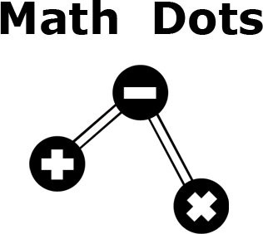
Cássio Rocha Scofield Souza
scofieldcassio@gmail.com
Erik Hane
ehane@kth.se

Slide 2
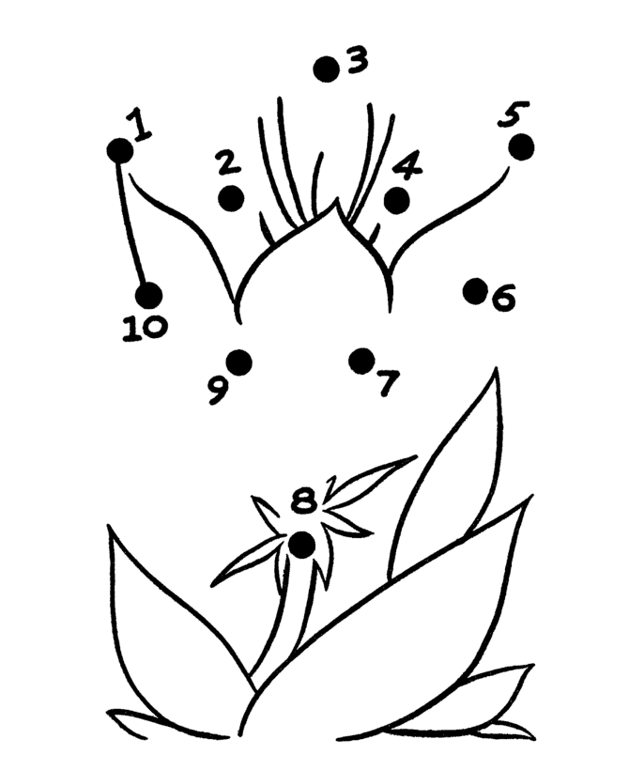
Objective
Create a tablet/smartphone version of the connect the dots game which can not only teach counting but also simple math such as addition, subtraction and multiplication.

Slide 3



Technology
Android
Moscrif
Javascript

Slide 4
Game Difficulties
Counting (1) (2) (3)
Addition (0+1) (1+1) (2+1)
Subtraction (2-1) (4-2) (6-3)
Multiplication (1*1) (1*2) (3*1)
Division (1/1) (2/1) (6/2)
Random (all of the above) (7-6) (2+0) (3/1)

Slide 5
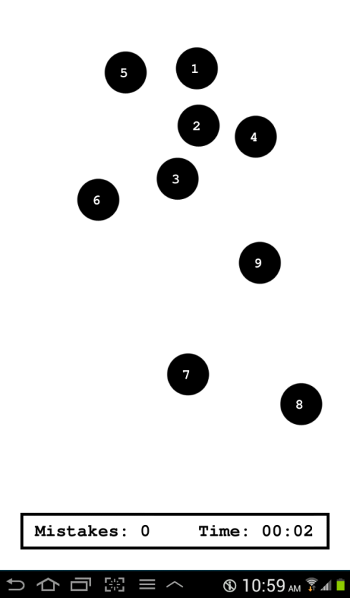
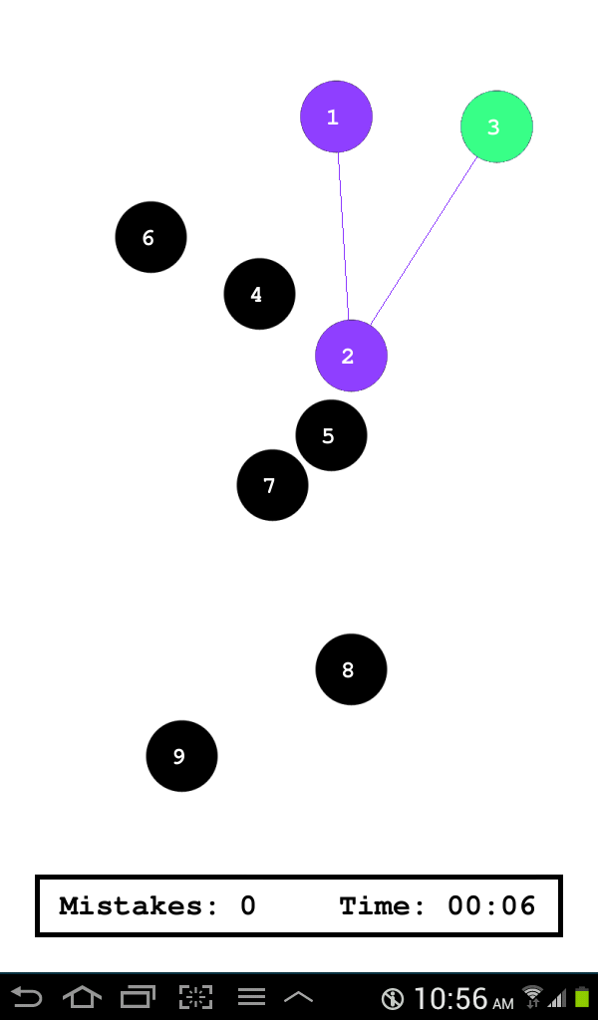
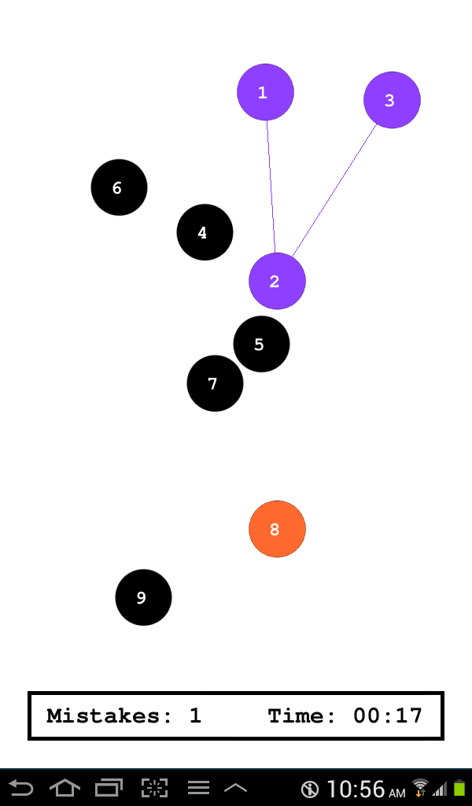
Interaction and Gameplay
New game
Correct move
Wrong move

Slide 6
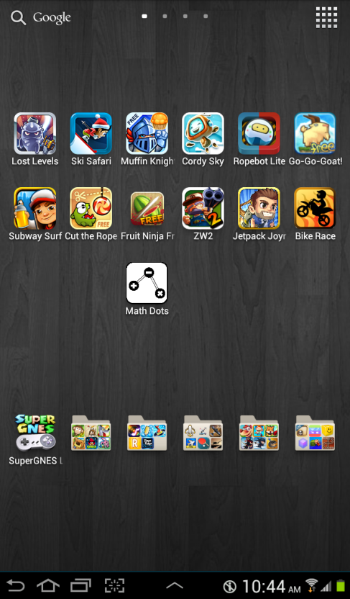
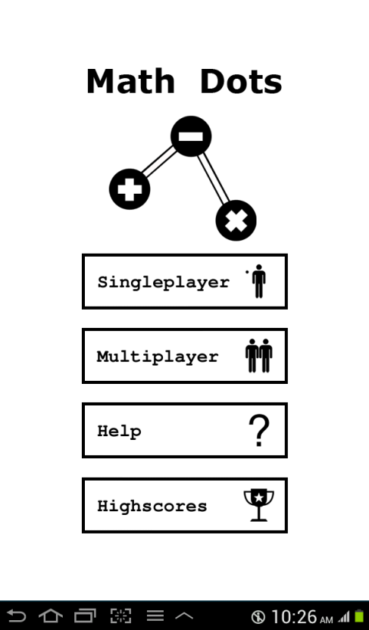
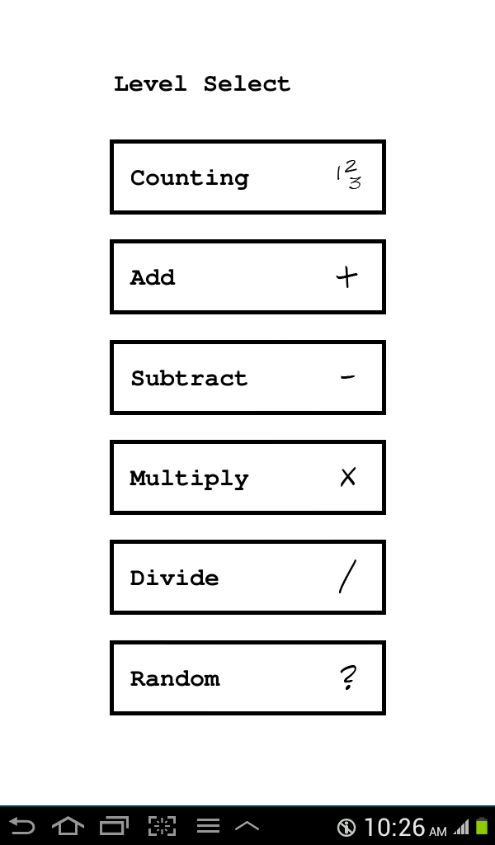
Screenshots - Main
Icon
Main Menu
Level Select Menu

Slide 7
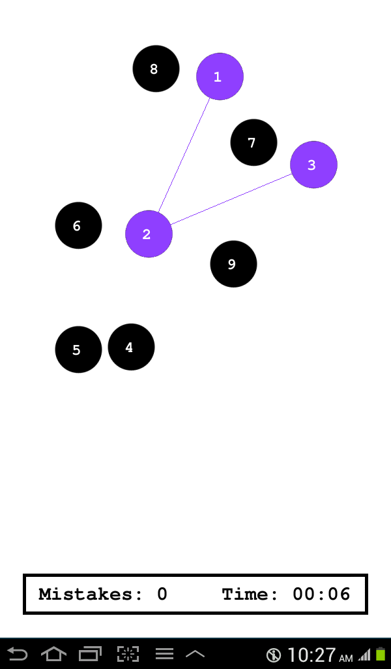
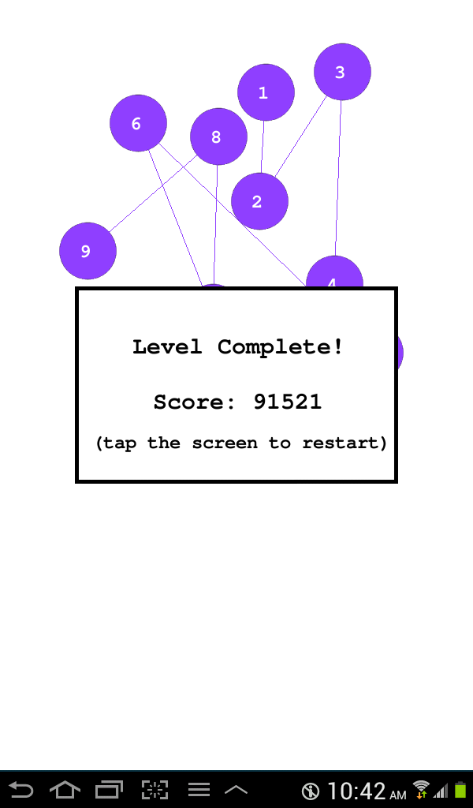
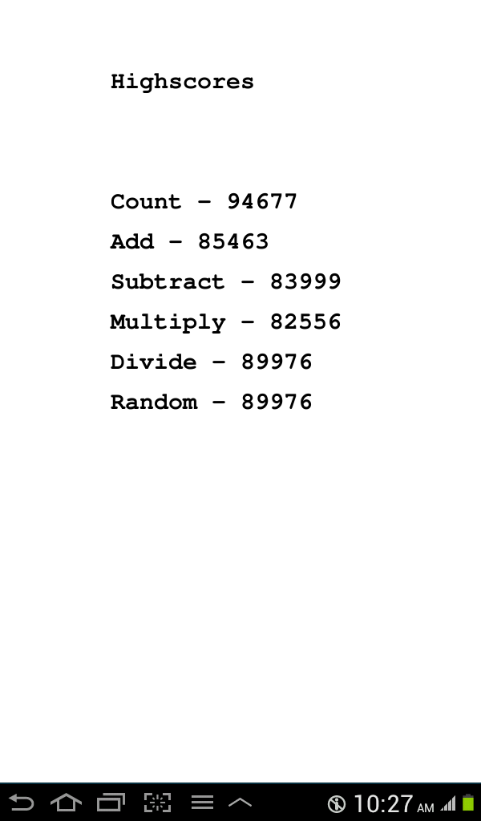
Screenshots - Game Modes
Singleplayer
  Player competes with his previous records, scoring is based on time and number of mistakes.

Slide 8
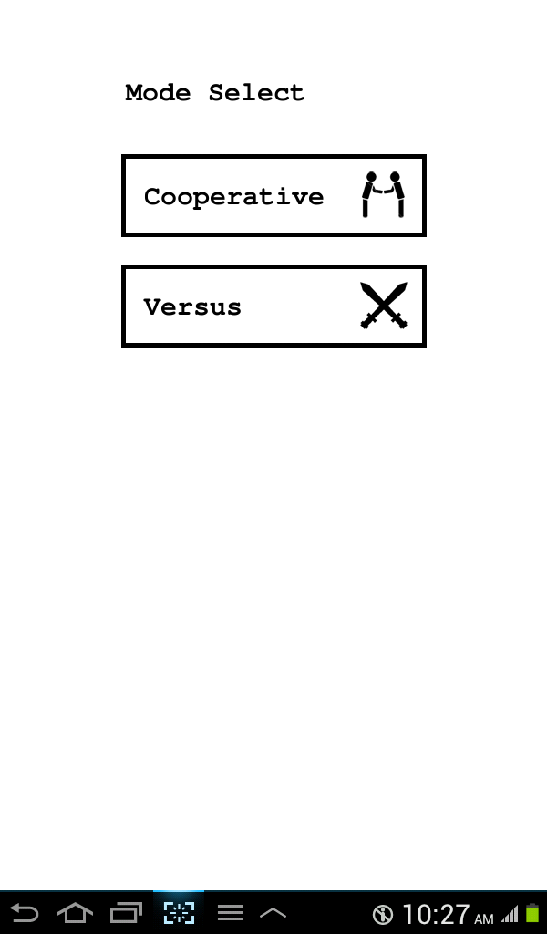
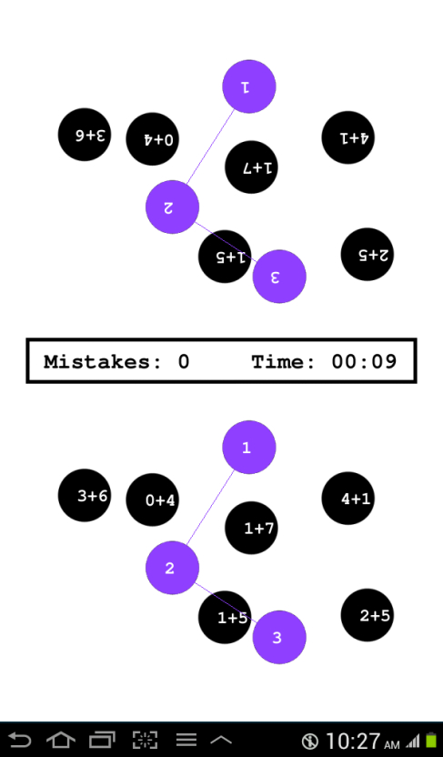
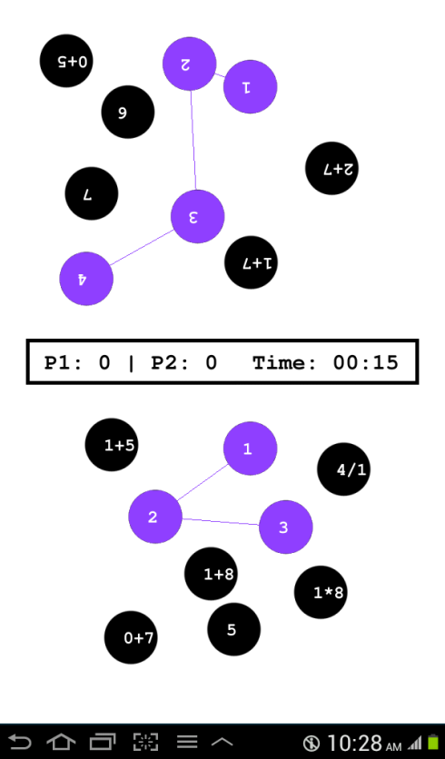
Screenshots - Game Modes
Cooperative Multiplayer
  Both players work together in the same screen and device . Same scoring system as singleplayer.
Competitive Multiplayer
  Players compete to form two figures with similar difficulty, the one that completes the figure first wins.

Slide 9
Demonstration
Download with your Android:
cassioscofield.com.br/files/MathDots.apk

